Slide 1
취업대비 코딩 테스트 실습 #7
2019.07
백지훈
jhbaik@moberan.com
이 문서는 나눔글꼴로 작성되었습니다. 설치하기

Slide 2
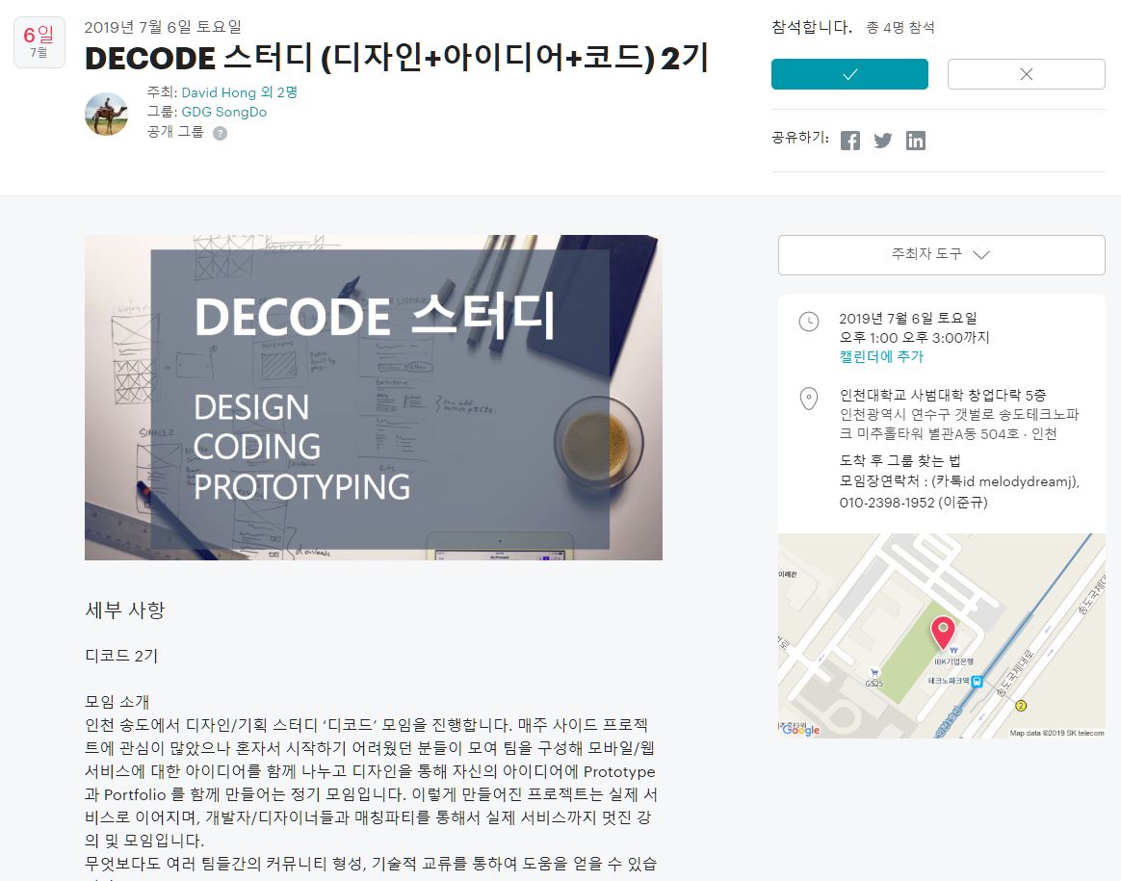
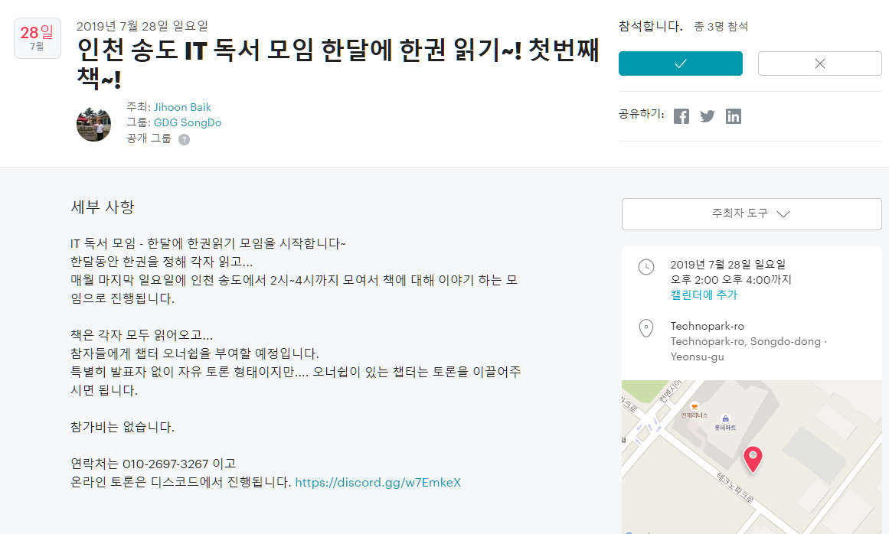
강의자료
https://github.com/zoops/201907-inu
https://www.meetup.com/GDG-SongDo/events/262774007
https://www.meetup.com/ko-KR/GDG-SongDo/events/262726909/
인천 데브 : https://incheon.devs.co.kr/
https://open.kakao.com/o/gHsHtdpb
GDG송도 : https://www.meetup.com/ko-KR/GDG-SongDo/
CivicHackers : https://discord.gg/vC6SxhF

Slide 3
강의소개
1.1 강의소개
문제풀이

Slide 4
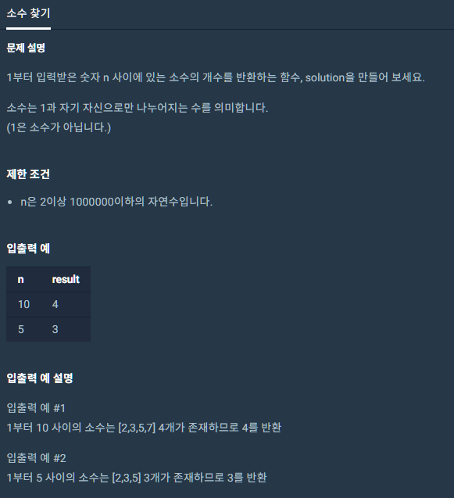
소수찾기
https://programmers.co.kr/learn/courses/30/lessons/12921

Slide 5
소수찾기-에라토스테네스의 체
https://en.wikipedia.org/wiki/Sieve_of_Eratosthenes

Slide 6
소수찾기-에라토스테네스의 체
#include <string>
#include <vector>
#include <cmath>
using namespace std;
int primes[1000000+1];
int solution(int N) {
int answer = 0;
if (N < 2 || N > 10000000)
return 0;
int sq = std::sqrt(N);
for (int p = 2; p <= sq; p++) {
if (primes[p] == 0) {
for (int i = p+p; i <= N; i=i+p)
primes[i] = 1;
}
}
for (int i = 2; i <= N; i++) {
if (primes[i] == 0)
answer++;
}
return answer;
}

Slide 7
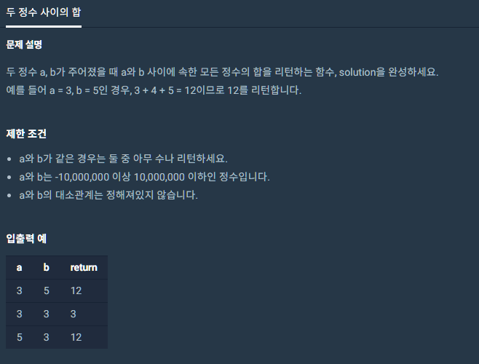
두 정수 사이의 합
https://programmers.co.kr/learn/courses/30/lessons/12912

Slide 8
등차 수열의 합
#include <string>
#include <vector>
using namespace std;
long long solution(int a, int b) {
long long answer = 0;
long long temp=0;
int tmp=0;
if(a > b){
tmp = a;
a = b;
b = tmp;
}
else if(a==b){
return a;
}
/*
for(int i=a; i<=b; i++){
temp += i;
}
answer = temp;
*/
answer = ((long long)(a+b))*((long long)(b-a+1))/2;
return answer;
}

Slide 9
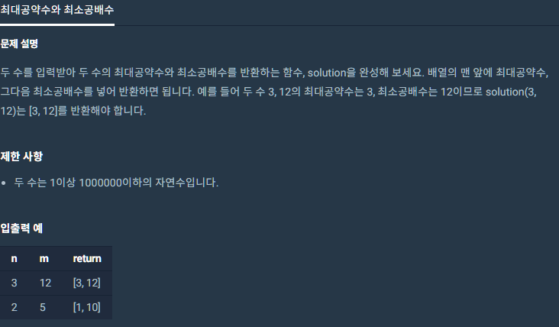
최대공약수와 최소공배수
https://programmers.co.kr/learn/courses/30/lessons/12940

Slide 10
#include <string>
#include <vector>
using namespace std;
vector<int> solution(int n, int m) {
vector<int> answer;
vector<int> dinominators;
int GCD = 0;
int LCM = 0;
for(int i = 1; i <= (n/2) && i <= (m/2); i++) {
if (n%i == 0 && m%i == 0) dinominators.push_back(i);
}
if (n < m) {
if (m%n == 0) dinominators.push_back(n);
}
else {
if (n%m == 0) dinominators.push_back(m);
}
GCD = dinominators.back();
answer.push_back(GCD);
LCM = GCD * (m / GCD) * (n / GCD);
answer.push_back(LCM);
return answer;
}

Slide 11
#include <string>
#include <vector>
using namespace std;
int gcd_recursion(int u, int v){
if (v == 0) return u;
else return gcd_recursion(v, u%v);
}
vector<int> solution(int n, int m) {
vector<int> answer;
int GCD = gcd_recursion(n, m);
answer.push_back(GCD);
int LCM = GCD * (m / GCD) * (n / GCD);
answer.push_back(LCM);
return answer;
}
유클리드의 알고리즘(호제법) 으로 최대공약수를 구하는 방법
- 인류 최초의 알고리즘

Slide 12
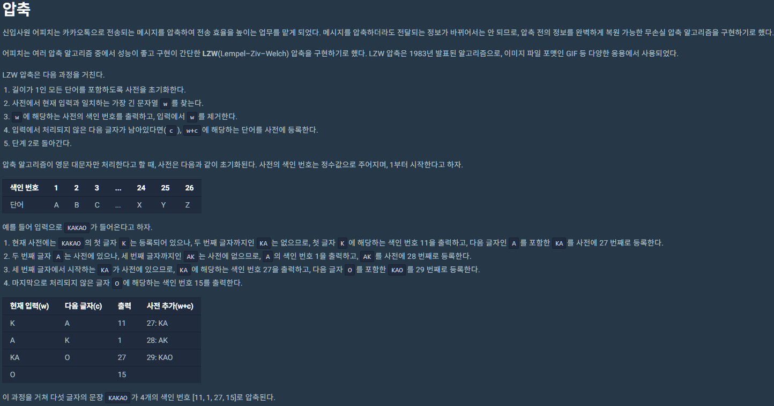
압축
https://programmers.co.kr/learn/courses/30/lessons/17684

Slide 13
#include <string>
#include <vector>
#include <map>
using namespace std;
vector<int> solution(string msg) {
vector<int> answer;
int idx = 1;
std::map<string, int> dic;
string d = "ABCDEFGHIJKLMNOPQRSTUVWXYZ";
for(char c : d) {
string v(1, c);
dic[v] = idx++;
}
string v = "";
string prev = "";
for (char c : msg) {
do {
v.append(1, c);
if (dic[v] != 0) {
prev = v;
break;
}
else {
answer.push_back(dic[prev]);
dic[v] = idx++;
v = "";
prev = v;
continue;
}
} while (true);
}
if (prev.empty() == false)
answer.push_back(dic[prev]);
return answer;
}

Slide 14
#include <string>
#include <vector>
#include <map>
using namespace std;
vector<int> solution(string msg) {
vector<int> answer;
int idx = 1;
std::map<string, int> dic;
string d = "ABCDEFGHIJKLMNOPQRSTUVWXYZ";
for(char c : d) {
string v(1, c);
dic[v] = idx++;
}
string v = "";
string prev = "";
for (char c : msg) {
v.append(1, c);
if (dic[v] != 0) {
prev = v;
}
else {
answer.push_back(dic[prev]);
dic[v] = idx++;
v = "";
v.append(1, c);
prev = v;
}
}
if (prev.empty() == false)
answer.push_back(dic[prev]);
return answer;
}

Slide 15
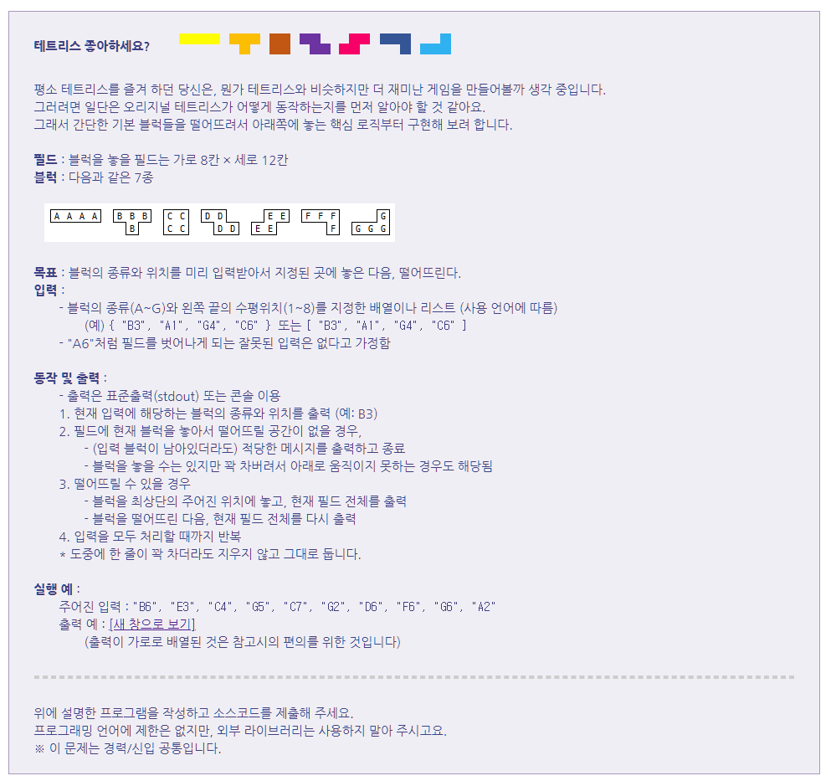

Slide 16
import java.util.HashMap;
import java.util.Map;
import java.util.Scanner;
public class Homework {
private static final int FIELD_HEIGHT = 12;
private static final int FIELD_WIDTH = 8;
private static final int B_FLAG = 1; // BLOCK FLAG
private static final int E_FLAG = 0; // EMPTY FLAG
private static final String EMPTY_FILED = ". ";
private static final int[][][] BLOCKS_ARRARY = {{
{B_FLAG, B_FLAG, B_FLAG, B_FLAG},
},{
{B_FLAG, B_FLAG, B_FLAG},
{E_FLAG, B_FLAG, E_FLAG},
},{
{B_FLAG, B_FLAG, },
{B_FLAG, B_FLAG, },
},{
{B_FLAG, B_FLAG, E_FLAG},
{E_FLAG, B_FLAG, B_FLAG},
},{
{E_FLAG, B_FLAG, B_FLAG},
{B_FLAG, B_FLAG, E_FLAG},
},{
{B_FLAG, B_FLAG, B_FLAG},
{E_FLAG, E_FLAG, B_FLAG},
},{
{E_FLAG, E_FLAG, B_FLAG},
{B_FLAG, B_FLAG, B_FLAG},
},
};
private static final Map<String, int[][]> BLOCK_MAP = new HashMap<String, int[][]>() {{
String btypes[] = { "A","B","C","D","E","F","G" };
for(int i = 0; i < BLOCKS_ARRARY.length; i++)
put(btypes[i], BLOCKS_ARRARY[i]);
}};

Slide 17
private String[][] field = new String[FIELD_HEIGHT][FIELD_WIDTH];
public Homework() {
for (int i = 0; i < field.length; i++)
for (int j = 0; j < field[i].length; j++)
field[i][j] = EMPTY_FILED;
}
private void doGameSolution(String[] blocks) {
for (String block : blocks) {
System.out.println("====================\nnext = " + block);
try {
String blockType = block.substring(0, 1);
int location = Integer.parseInt(block.substring(1, 2)) - 1; // location to index
makeTempField(blockType, location);
printField();
System.out.println("--------------------");
makeResField(blockType, location);
printField();
System.out.println("====================");
} catch (ArrayIndexOutOfBoundsException e) {
System.out.println("not enough space");
break;
}
}
}

Slide 18
// 입력받은 값을 배열에 저장 메서드
public String[] parseInput(String input) {
String[] InputArray = {};
InputArray = input.trim().toUpperCase().replace(" ", "").replace("\"", "").split(",");
return InputArray;
}
// 2차원 배열 출력 메서드
public void printField() {
for (int i = 0; i < field.length; i++) {
for (int j = 0; j < field[i].length; j++)
System.out.print(field[i][j]);
System.out.println();
}
}
private void markBlock(String blockType, int blockShape[][], int y, int x) {
for(int i = 0; i < blockShape.length; i++)
for(int j = 0; j < blockShape[i].length; j++)
if (blockShape[i][j] == B_FLAG)
field[y + i][x + j] = blockType + " ";
}
// makeTempField: 블록을 떨어뜨리기 전 필드배열 생성 메서드
// 위치가 틀린 블럭은 들어오지 않는다.
public String[][] makeTempField(String blockType, int location) throws ArrayIndexOutOfBoundsException {
int blockShape[][] = BLOCK_MAP.get(blockType);
for(int i = 0; i < blockShape.length; i++)
for(int j = 0; j < blockShape[i].length; j++)
if (blockShape[i][j] == B_FLAG && field[0 + i][location + j] != EMPTY_FILED)
throw new ArrayIndexOutOfBoundsException("not enough space");
markBlock(blockType, blockShape, 0, location);
return field;
}

Slide 19
// makeResField : 블록 떨어뜨린 후 필드배열 생성 메서드
public String[][] makeResField(String blockType, int location) {
int blockShape[][] = BLOCK_MAP.get(blockType);
// tempField 복구
for(int i = 0; i < blockShape.length; i++)
for(int j = 0; j < blockShape[i].length; j++)
if (blockShape[i][j] == B_FLAG)
field[0 + i][location + j] = EMPTY_FILED;
for (int y = 0; y < field.length; y++) {
for (int i = 0; i < blockShape.length; i++) {
for (int j = 0; j < blockShape[i].length; j++) {
if (blockShape[i][j] == B_FLAG && ( (y+i) >= field.length || field[y + i][location + j] != EMPTY_FILED) ) {
markBlock(blockType, blockShape, y - 1, location);
return field;
}
}
}
}
return field;
}
public static void main(String[] args) {
Scanner sc = new Scanner(System.in);
Homework game = new Homework();
String jum = sc.nextLine();
String[] input = game.parseInput(jum);
game.doGameSolution(input);
}
}

Slide 20
감사합니다
강의자료
https://github.com/zoops/201907-inu
이 문서는 나눔글꼴로 작성되었습니다. 설치하기

